Slide 1

Avoiding Catches
For all your tools, standard and carbide, gouges, scrapers and skews

Slide 2

What does the following advice have to do with catches?
Anchor the tool on the tool rest
Find the Bevel of the tool
Control the Cut
It is all about the forces at work to take control of the tool from us!

Slide 3
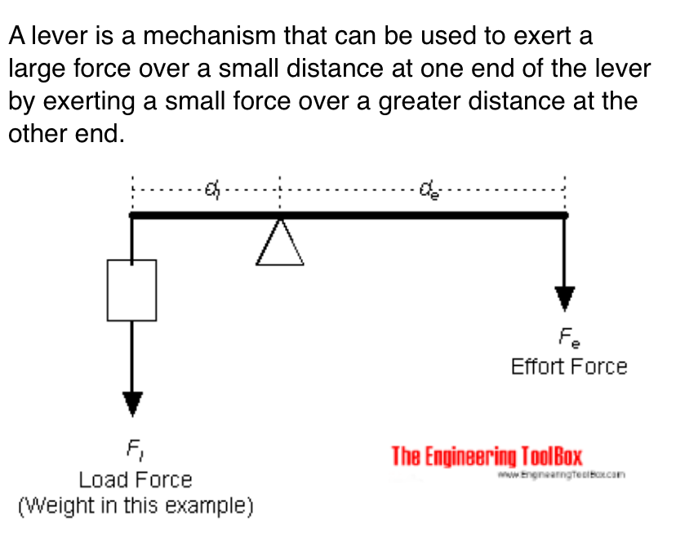

Anchor the tool on the tool rest - ALWAYS
Safety, safety, safety
Defines the ‘pivot point’ affecting leverage, you want at least 5x the ‘stick out’ (left of pivot in image below) on your side!
Simplified weight * length of lever = force, horsepower of lathe motor and inertia of spinning wood is weight * stick out leverage

Slide 4
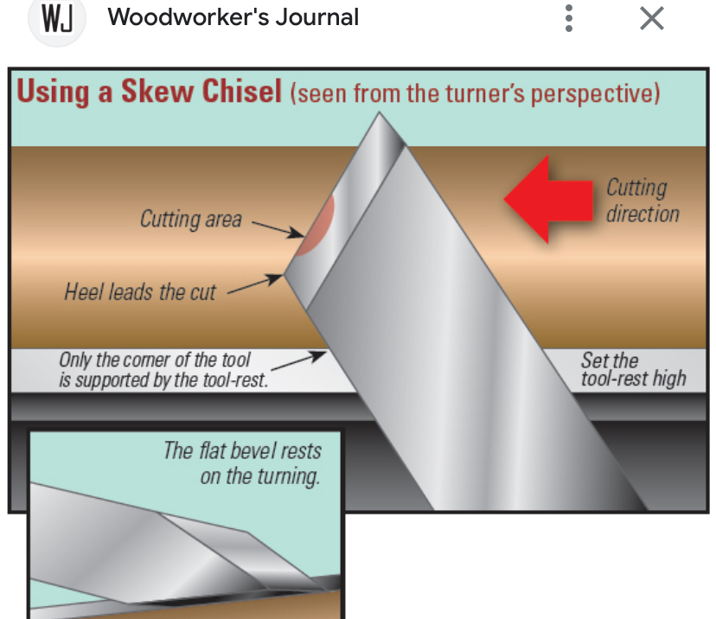
Find the Bevel of the tool before start of cut
Distance of the portion of bevel as it rubs on the wood from the pivot point also affects ‘twisting leverage’ imposed on your cut - multiplies the twisting force of the cut in terms of distance of the supported cutting edge from the pivot point. Easiest to visualize with a skew chisel example…
Looking at the skew in this image the ‘lower 1/3’ of the skew edge is closest to the tool rest support and thought of as the ‘green zone’, the least likely to catch.
The ‘middle 1/3’ of the skew chisel edge is said to be a ‘yellow zone’ where catch is more likely.
The ‘top 1/3’ of the skew chisel edge is a ‘red zone’ where you are very likely to get a catch!
For ANY TOOL, the further your cut is from the tool rest supported portion of the tool the more likely it is to catch!

Slide 5
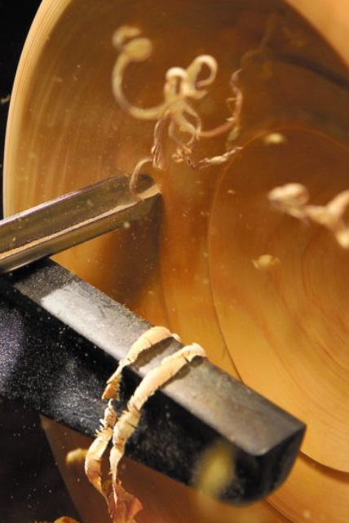
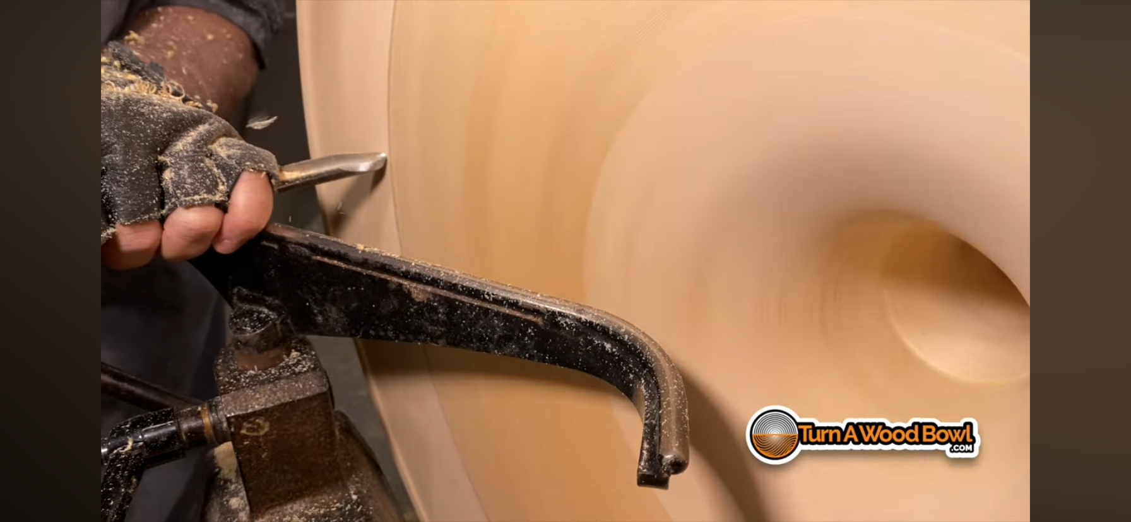
Control the Cut
Nullify the forces leading to a catch by turning any unexpected force or twist into a reduction or even ending the cut.
In this example we are turning from left to right using the edge to the right of the point. A minor catch or drag (or big one) will reduce or terminate the cut, no catch!
What happens if we cut from left to right riding the bevel to the left of the point and we get a minor catch or drag? That edge will DIG DEEP into our turning, severe catch!

Slide 6
What can be done to reduce catches when we scrape or cut without bevel support?
Forces working against you are pushing down on your tool or twisting on your tool are ‘moving’ the edge as you cut.
This is usually communicated in vibration felt in the handle of the tool or ‘tool chatter’ marks on the surface of the wood.
There is no ‘pivot point’ close to the cutting edge on the supporting bevel to absorb these forces OR to help you control the cut!
If the cutting edge ‘digs in’ as it is moved by these forces a catch or skate (big or small) will happen.
The ONLY thing that can be done is to reduce the forces working against you – sharp tools, reduced ‘stick out’, good technique, etc.

Slide 7
Demonstrations
Tool rest usage
Cuts with gouges
Presentation on the Skew Gouge

